Slide 1
Save It For Later
For Teachers and Administrators
Provided by the LAUSD Food Services Division
April 12, 2016
Notes:
THIS IS JUST A PLACE HOLDER FOR SCREEN BEFORE THE PRESENTATION IS READY TO BEGIN

Slide 2
Save It For Later
For Teachers and Administrators
Provided by the LAUSD Food Services Division
April 12, 2016
Notes:
TELL: Welcome to the Save it For Later training. Thank you for being here today. My name is (state your name)
This presentation will inform you of the Save it for Later initiative implemented by the LAUSD Food Services Division.

Slide 3
Overview
The Save It For Later program is designed to reduce waste and provide students with the choice of eating select menu items at a later time during the day.
This training will provide an understanding of:
Benefits of the Save It For Later initiative
What food items students can save for later
What food items can be declined
BIC and Lunch implementation strategies
Individuals responsibilities
Food Donation Program
Notes:
TELL: Food Services is implementing the Save it For Later initiative to reduce waste while still providing quality nutritious meals to students. In this training, we will go over the benefits of the Save it For Later initiative, the food items that can be saved by students for later consumption along with the food items that can be declined so we avoid waste. We will also discuss how Save it For Later will be implemented during both BIC and Lunch meal service and will go into detail of the responsibilities of the teachers, students and food service managers. In addition to that we will discuss the LAUSD food donation program.

Slide 4
Purpose And Benefits
Save It For Later, will provide benefits for students by:
Permitting students to decline select menu items during breakfast and lunch
Allowing students to save food items they do not wish to consume during breakfast and lunch
Improving ordering and food preparation procedures to minimize the amount of leftover food
Notes:
TELL: Save it For Later, will provide benefits for students by permitting the students to decline select menu items during breakfast and lunch. It also allows students to save food items they do not wish to consume during breakfast and lunch to eat at a later time during the day. Processes have also been designed to improve ordering and food preparation procedures to minimize the amount of leftover food remaining after BIC and lunch meal service periods.

Slide 5
Objective
The Save It For Later (SIFL) initiative will:
Respond to the many complaints and concerns around how to manage food waste
Encourage healthy eating habits throughout the day
Allow students to choose from select menu items and consume them at a later time in the day
“It’s not nutrition, until it’s eaten.”- USDA Food and Nutrition Service
Notes:
TELL: Save it For Later will manage food waste and encourage healthy eating habits by allowing students to choose from select menu items to be consumed at a later time. We’ve heard the concerns regarding food waste and the Food Services Division is committed to reducing food waste where possible. Students will appreciate the Save it for Later program which benefits them by allowing them to eat items at a later time.

Slide 6
Pilot Program Implementation
20 pilot sites were selected to participate in the Save It For Later Initiative (SIFL)
The pilot program will be implemented between April 18th and May 6th
Training for teachers and school staff will begin on April 11th
The trainings will be similar to how BIC trainings were conducted
SIFL has 2 main implementation components:
Setting up of sharing tables in the classrooms
Providing students the option to eat food at a later time
The cafeteria team will help students understand the indicators of what they can save
Notes:
TELL: Food Services is implementing the Save it For Later initiative between April 18th and May 6th at 20 approved pilot sites. Save it For Later has 2 main implementation components. The first is setting up sharing tables and the other is providing students with the option to eat food at a later time. The cafeteria team will help students understand how to determine what they can save. Training for teachers and school staff will begin on April 11th and will be similar to how BIC trainings were provided. This is all in an effort to reduce waste while still providing quality nutritious meals to students.

Slide 7
Policy on Food Consumption Outside of Food Service Area
The USDA Memo Code: SP 41-2014 provides clarification on food consumption outside the food service area which states:
With limited meal periods and increased amounts of fruits and vegetables offered, students may be inclined to save select items for a later time
Notes:
TELL: Let’s first discuss the policy on saving food. The USDA memo code SP 41-2014 provides clarification on food consumption outside of food service areas and states that the USDA recognized that with limited meal periods and an increased amounts of fruits and vegetables offered as part of the meals, some students may be inclined to save some items for consumption at a later time. Program operators should be aware of all applicable State and local food safety regulations, and that this flexibility is intended to address practical constraints that may prevent students from consuming their entire meal in the food service area during the meal period.

Slide 8
What Menu Items Can Be Saved?
The following menu items can be saved by students for later consumption. These food items will be identified on the monthly menu with an (S).
Breakfast Menu Items | Lunch Menu Items
Whole Fruit | Whole Fruit
Café LA Coffee Cake | Applesauce Cup
Dry Cereal | Bagged Baby Carrots
Cinna-Crisps | Breadsticks
 | Dinner Roll
 | Granola
 | Tortilla Chips
Notes:
TELL: Here you can see the breakfast and lunch items that students are able to SAVE FOR LATER. For breakfast, all dry fruit, whole fruit can be saved along with our wonderful coffee cake provided it has not been opened, and any of our dry cereal. For lunch, students will now be able to save whole fruits, sealed applesauce cups, bagged baby carrots, wrapped breadsticks and dinner rolls, packed granola, and tortilla chips. All of these items will be easily identifiable on the menu with a clearly marked (S) letter next to them.

Slide 9
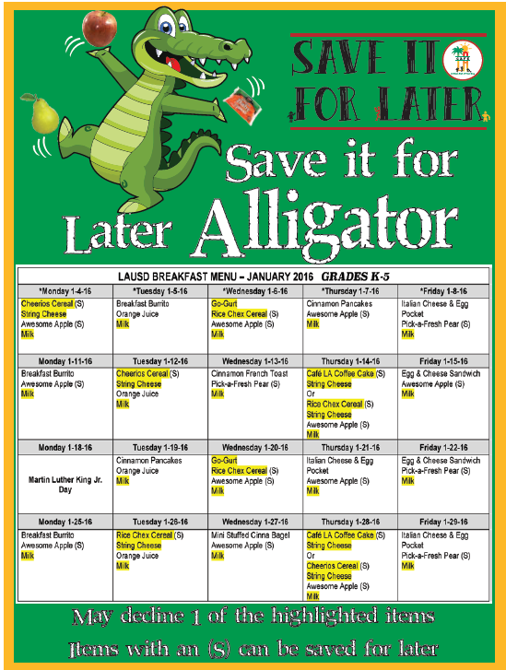
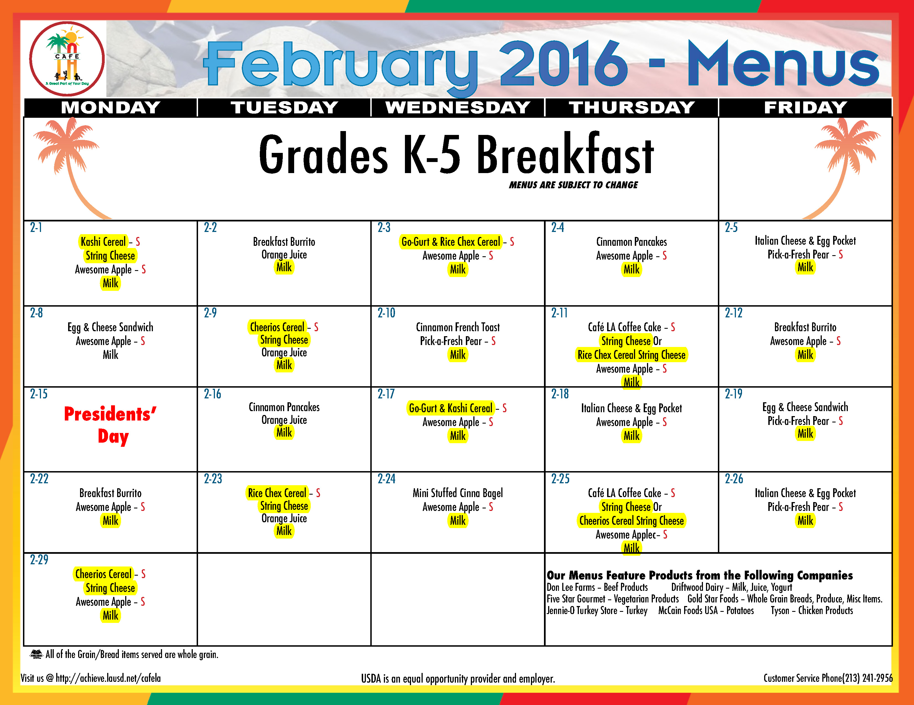
Save It For Later Breakfast Signage
The food items highlighted on the monthly menu indicate which items may be declined by the students.
Only 1 food item may be declined
This will qualify as a reimbursable meal
Food items marked with an (S) can be saved.
Notes:
Tell: Here is an example of the monthly menu which points out two key elements . Every day's menu is different when it comes to items that can be saved for later and items that can be declined in order for meals to be reimbursable. What you’ll notice consistently is that Milk can always be declined for meal reimbursement.
Click: You’ll also notice that the items marked with an (S) on this particular day are foods that can be saved for later. Each day will have the same indicators.

Slide 10
Save It For Later Lunch Signage
The Save It For Later lunch sign informs students of the food items that may be saved.
Food Items marked with an (S) on the lunch menu can be saved
Notes:
Tell: During lunch, students will refer to the monthly menu for guidance with the selection process. Similar to Breakfast service, the menu will point out the items offered for the day. And again, the items marked with a letter (S) can be saved for later. Encourage students to eat all the items they select, but if they don’t encourage them to use the sharing table because another student may want an item from the table.
The USDA allows students to save food items for consumption outside of a meal service area as long as the food item does not require cooling or heating. For example on Tuesday you have the whole fruit item____ and ______ that can be saved from lunch

Slide 11
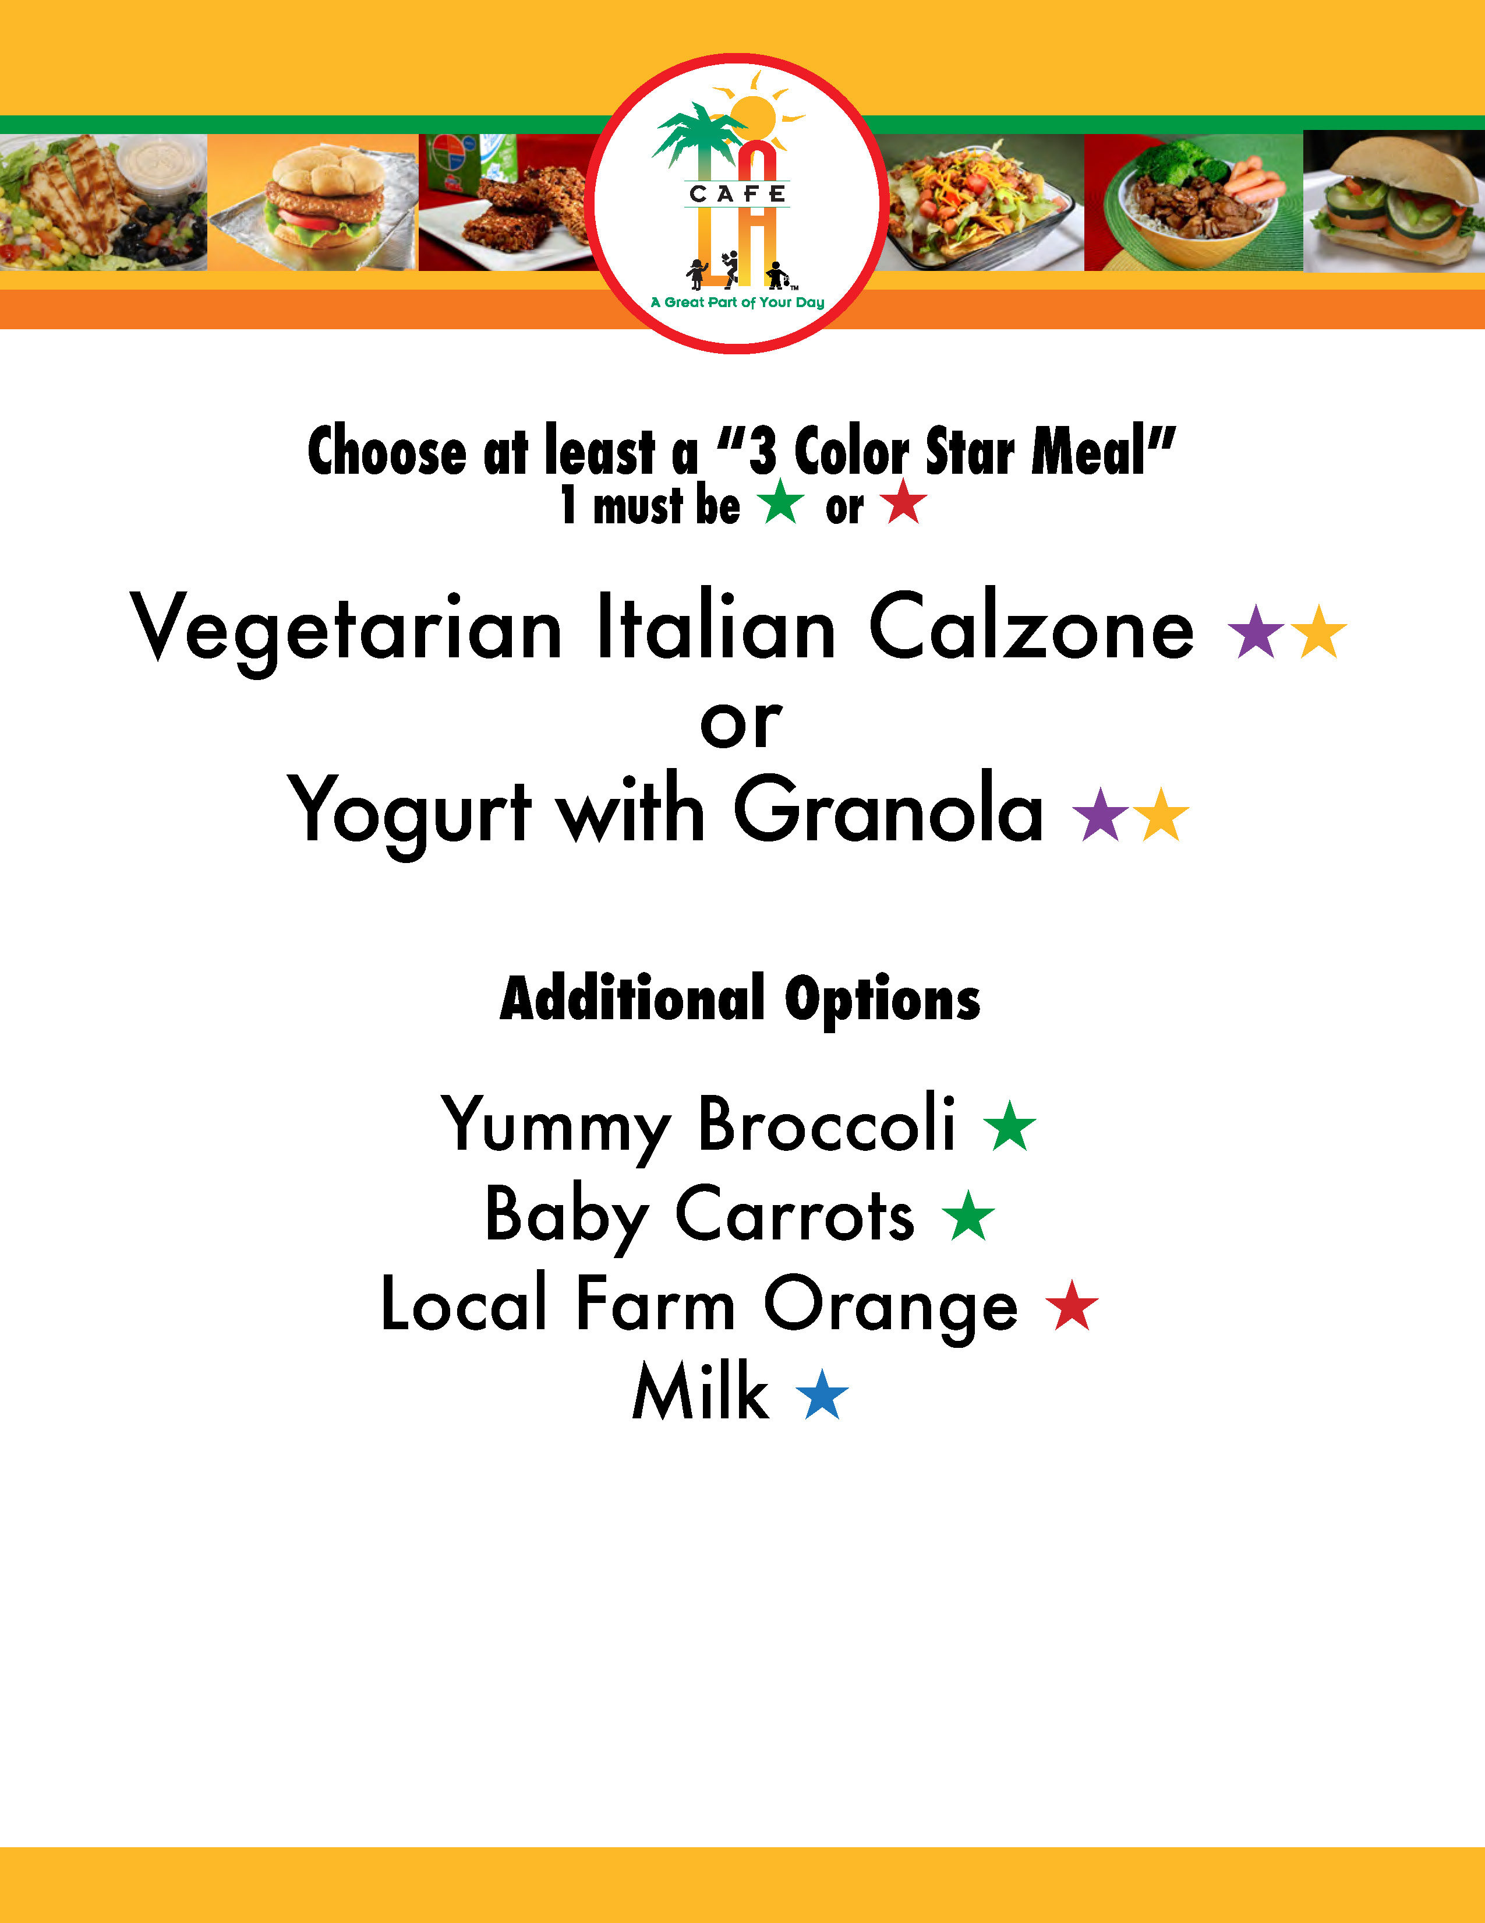
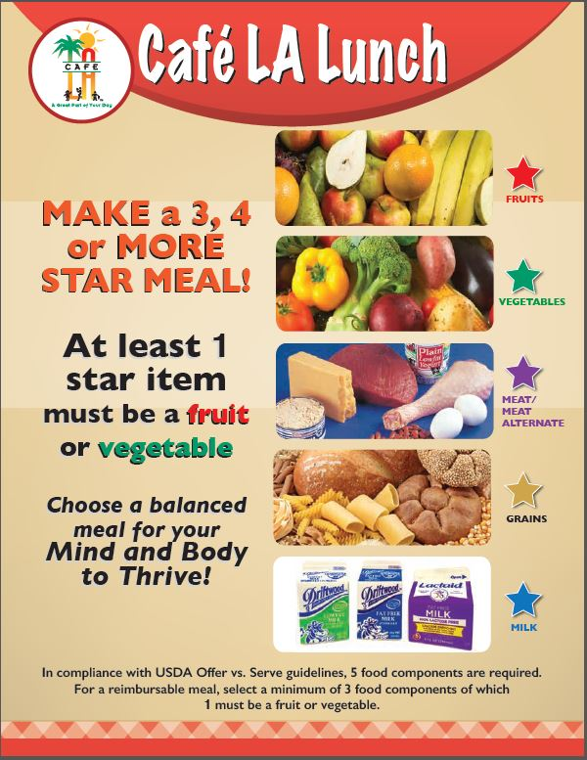
The 5 Star Meal Signage
The 5 Star Meal Poster will guide the students on how to select a reimbursable meal.
Each food component has a specific colored star indicator.
Students build a reimbursable meal by selecting 3 or more stars (1 must be a fruit or vegetable)
Notes:
Tell: Students will also refer to the 5 star meal signage for guidance with the selection process. The menu will point out the items offered for the day but this poster will teach kids how to choose a reimbursable meal the District can claim and get paid for by following the “Star” guidelines. You’ll notice each food component has a specific colored star so all students will have to do is select 3 or more stars with 1 being a fruit or vegetable.
Click
Then the example and the menu for the day and how to select the proper meal

Slide 12
What Is A Sharing Table?
Sharing tables are where students can place unconsumed food and beverage items (pre-packaged food and beverages, unopened wrapped food and beverages, or food items with a peel) that they choose not to eat/drink.
Sharing tables can be established in the:
Classroom during BIC
Lunch eating area
Notes:
Tell: So What is a sharing table?
Sharing tables are where children can place unconsumed food and beverage items. These items include pre-packaged food items and beverages, unopened wrapped food and beverages, or food items with a peel.
These sharing tables can be found in the classroom during BIC or in the lunch eating area.

Slide 13
The Benefits of Sharing Tables
In an effort to reduce the amount of food waste and encourage the consumption of the food served, school food service operations have established sharing tables.
The sharing table will:
Provide an opportunity for other children to take additional helpings of food or beverages
Encourage the consumption of fruits and vegetables
Reduce food waste
Notes:
Tell: In an effort to reduce the amount of food waste and encourage the consumption of the food served, school food service operations have established sharing tables on their school campuses.
The sharing tables will provide an opportunity for other children to take additional helpings of food or beverages, encourage the consumption of fruits and vegetables, and potentially reduce food waste. This is made possible by the USDA’s creative measures to reduce food waste and improve nutrition amongst students.

Slide 14
Save It For Later Classroom Guidelines
Teachers and students are encouraged to facilitate the following in their classroom:
Designate a sharing table
Encourage students to save non-perishable food items from their own meal and from the sharing table
Return all unserved food (not removed from the BIC bags) back to the cafeteria
Discard all remaining leftover food items from the students desks and sharing tables
Notes:
TELL: Teachers and students are encouraged to facilitate a few simple steps in their classrooms. The first step is to designate a sharing table. The sharing table is a location where students can place items they do not wish to eat and where other students can select second servings of food items to consume. Students should be encouraged to save non-perishable food items from their own meal and from the sharing table that they may eat at a later time. The BIC delivery team will return all unserved food that has not been removed from the BIC bags back to the cafeteria. Lastly, students will discard all remaining leftover food items from the their desks and the sharing tables. Any items left on the sharing table should be discarded when meal service is over.
For example, if a class receives 20 meals and only 10 kids take a breakfast, we expect 10 complete breakfast to be returned to the cafeteria.

Slide 15
BIC Meal Classroom Guidelines
Here are a few reminders on how to run a successful BIC program in the classroom.
Pre-setting meals for students on their desks is not permitted
Use a check mark on the roster to indicate if a meal is taken
Use a dash mark on the roster to indicate absent or non participating students
Students are not required to take a meal during BIC
All unserved meals must be returned to the cafeteria inside the BIC bags
Notes:
TELL: Here are a few reminders on how to run a successful BIC program in the classroom. The pre-setting out of meals for students on their desks is not permitted, students must select their own meal, and the roster must be marked immediately using a check mark when a meal is taken and a dash mark if a child is absent or not participating for the day. It is also important to note that not all children are required to participate in BIC, and all unserved meals are to remain in the BIC bags and be returned back to the cafeteria.

Slide 16
Food Service Manager’s Responsibility
For Breakfast the Food Services Manager should:
Determine the forecasted amounts based on each individual classroom’s participation
These amounts may fluctuate depending on the menu served
Order food based on the forecasted projections
Receive unserved food returned in the BIC bags
Take food temperatures of returned food items and either: discard, return to stock, or donate
Any leftover food will be eligible for donation to an approved donation program
Notes:
TELL: The Food Service Manager carries an important role in the reduction of food waste on the campus. Managers will determine a forecast of food items by analyzing each classrooms participation levels. By understanding that these amounts fluctuate day to day, depending on the menu served the FSM will have the information needed to correctly order the amounts that would not result in excessive waste. When breakfast service is over, cafeteria’s will receive the unserved food remaining in the BIC bags from the classrooms and will check the food temperatures of potentially hazardous foods and will either discard, return items back to stock, or donate to an approved donation program. It is important to note that sharing table items must be disposed of and cannot be donated.

Slide 17
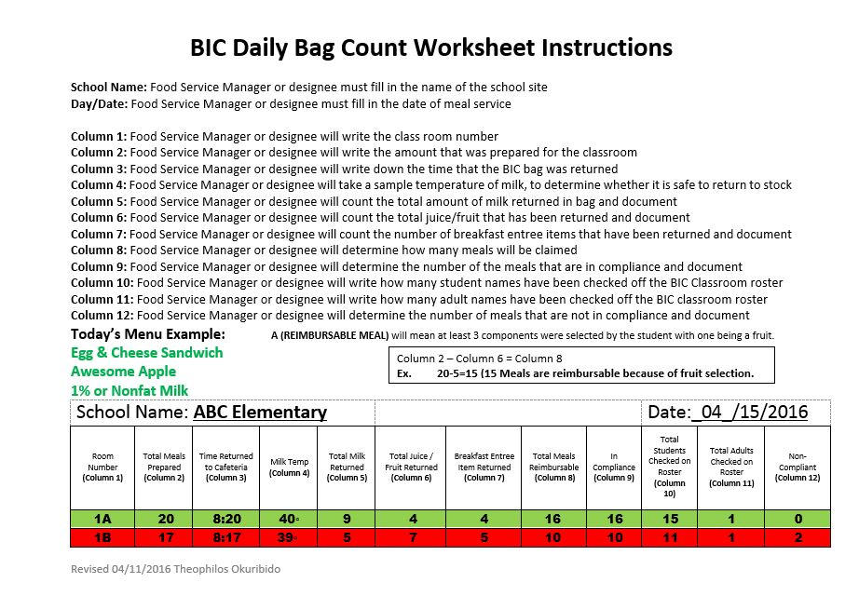
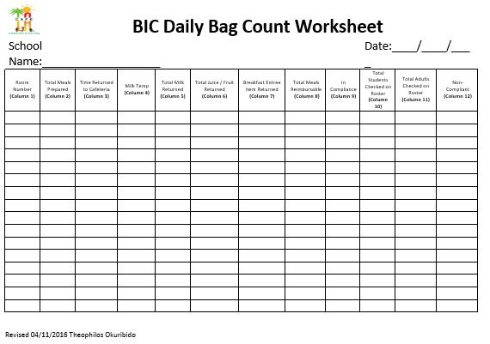
BIC Daily Bag Count Worksheet Example
Notes:
TELL: What is essential to the success of our breakfast program is the tracking and claiming of meals properly. What this means is that the food service manager will order food based on accurate projections according to the classroom participation amounts. The BIC Daily Bag Count Worksheet tracks the amount of food provided for each classroom, broken down into 12 columns that allows the food service manager or a designated staff member to self-audit every classrooms bags. If any discrepancies occur, they can be addressed accordingly. This slide shows the details instructions on how to complete the worksheet. Click then Tell: Here is an example of a day where egg & cheese sandwiches were served. As you can see by the quantities returned, the participation amounts resulted in food returned to the cafeteria resulting in waste. The manager will make necessary adjustments to avoid food waste in the future.

Slide 18
Food Service Manager: Responsibilities During Lunch
During lunch the Food Service Manager should:
Work with the administration to designate a sharing table in the lunch area away from the POS (Point of Sale) terminal
Count and document leftover food items not served to students
Record temperatures of unserved food items
Donate leftover unserved food items to an approved donation program
Notes:
TELL: During lunchtime, Food Service Managers will work with the sites administration to designate a sharing table in the lunch area away from the POS (Point of Service) terminal. At the end of lunch service, the Food Service Manager will designate a staff member to count leftover food items in the kitchen that are eligible for the food donation program. The cafeteria staff member will take the food temperatures and document the food temperature on the food temperature log. After the food temperature determines the food is safe for consumption, the leftover food items will be donated to the designated non-profit agency.

Slide 19
Food Donation Program
If you would like information on setting up a new non-profit agency for food donations at your schools:
Contact the agency of your choice and have them contact Food Services for the agreement and procedures or
Utilize one of the agencies already approved listed on the Café LA Website at http://achieve.lausd.net/FoodDonation
Notes:
TELL: In April 2011, the Board of Education passed a resolution which allowed the District to donate excess food to needy families and children. The donated food is limited to packaged food items that have not been served to our students. If you would like information on setting up a new non-profit agency for food donations at your schools simply contact the agency of your choice and have them contact Food Services for the agreement and procedures or you can utilize one of the agencies already approved that have been listed on the Café LA Website at http://achieve.lausd.net/FoodDonation

Slide 20
Approved Food Donation Programs
Non-Profit Organizations approved for the Donation programs are listed below.
Helping Other People Excel - H.O.P.E
JFS/SOVA Community Food & Resource Program
The Salvation Army - East Los Angeles Temple Corps Association
Fred Jordan Mission
Weingart Center
Notes:
TELL: The District has several Non-Profit Organizations approved for the Donation programs. These organizations include Helping Other People Excel - H.O.P.E, the JFS/SOVA Community Food & Resource Program, The Salvation Army - East Los Angeles Temple Corps Association, the Fred Jordan Mission, and Weingart Center. The current list of Non-Profit Organizations approved for the Donation program can be found on the Food Service Division website under the principals resource page.

Slide 21
References
http://www.fns.usda.gov/e-updates/its-not-nutrition-until-its-eaten-behavior-change-key-nutrition
California Civil Code Section 1714.25 “donated food and protection from liability”: http://leginfo.legislature.ca.gov/faces/codes.xhtml
http://www.cde.ca.gov/ls/nu/sn/mbusdacnp042012.asp
Notes:
The following references are great resources to visit for additional information.

Slide 22
Questions?
Thank you!
LAUSD Food Services Division
Nourishing Children to Achieve Excellence
Notes:
If you have any questions regarding the Smarter Lunchroom, please contact Theo at the Food Services Division.
213-241-2956

